Slide 1
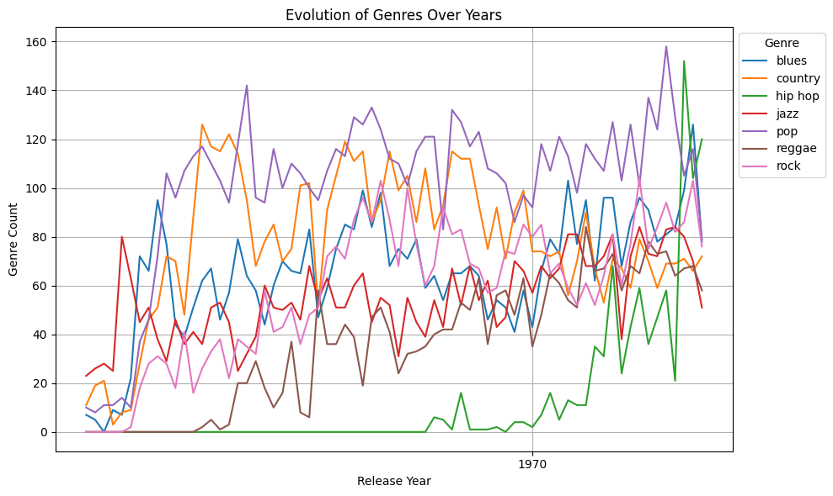
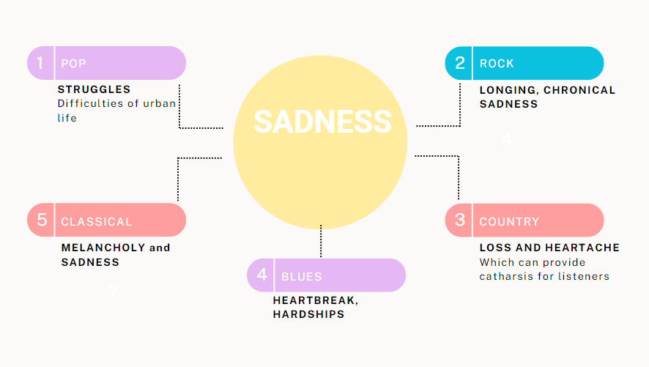
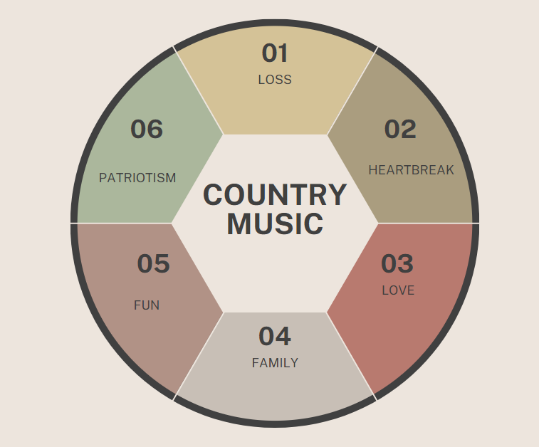
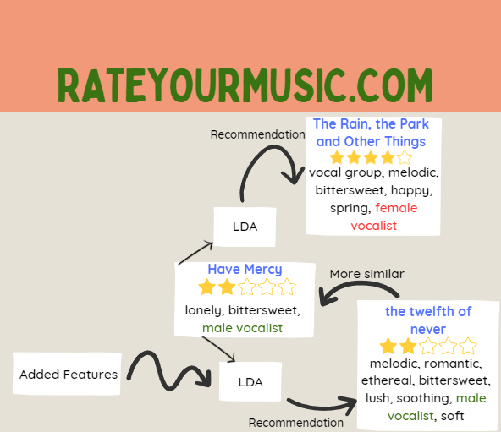
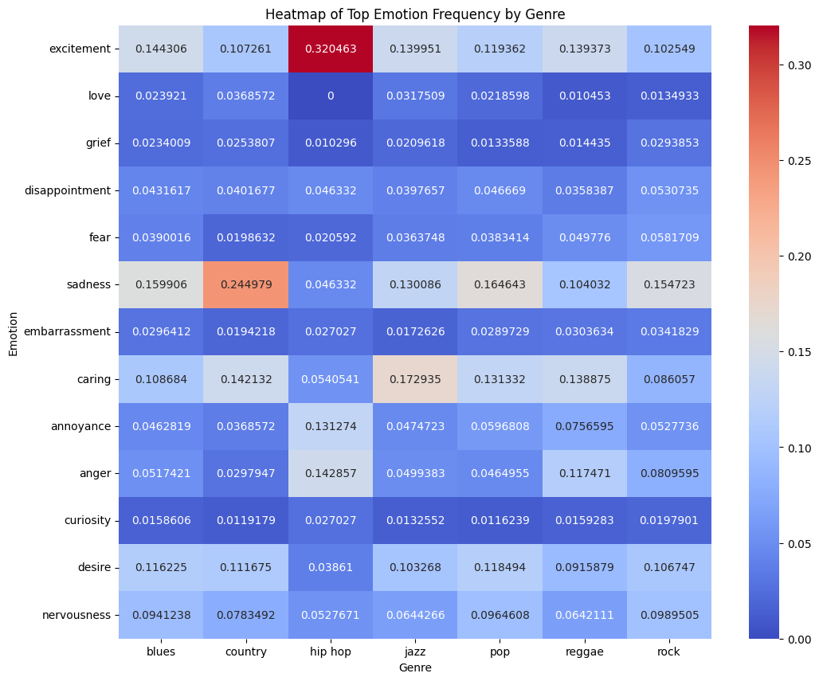
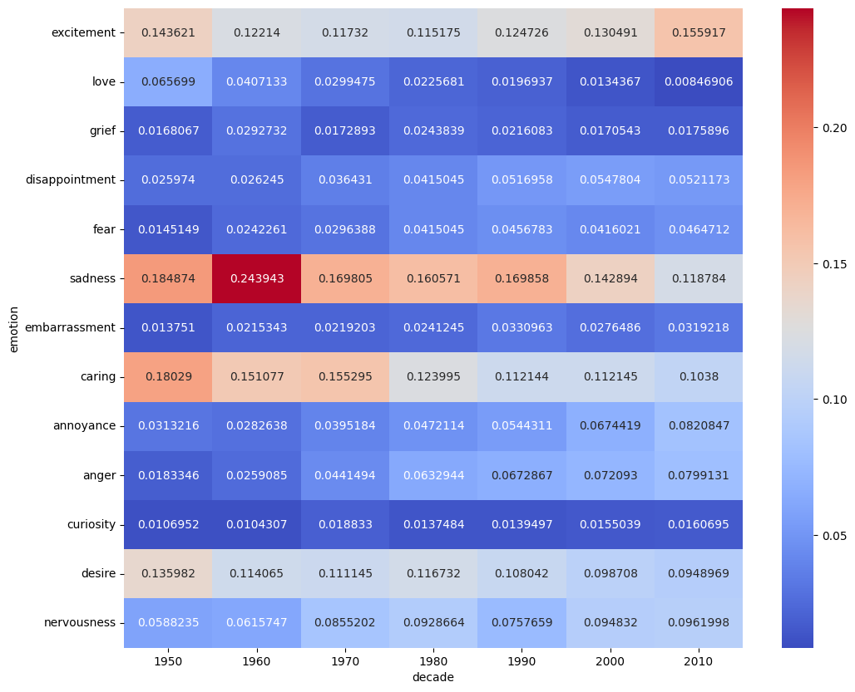
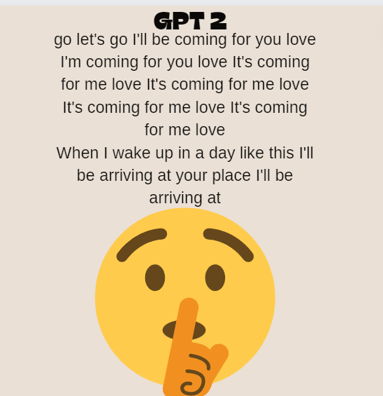
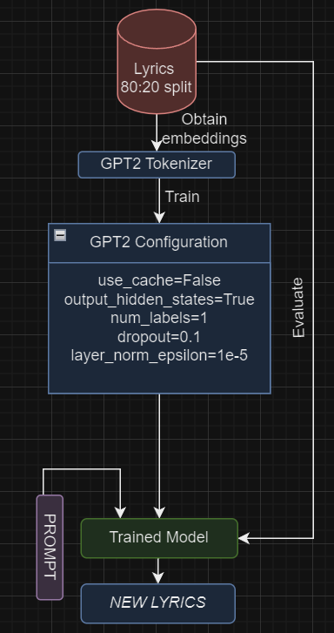
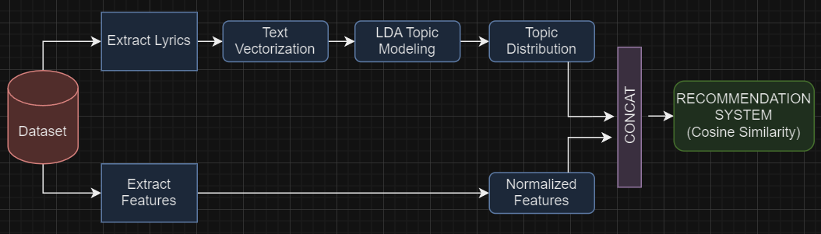
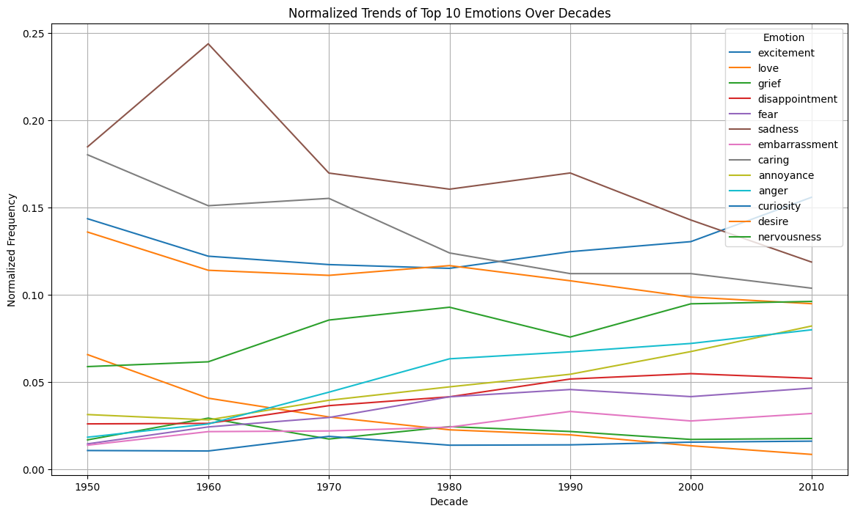
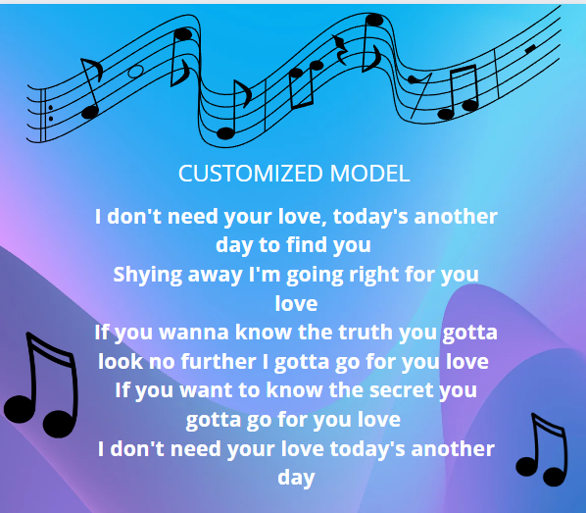
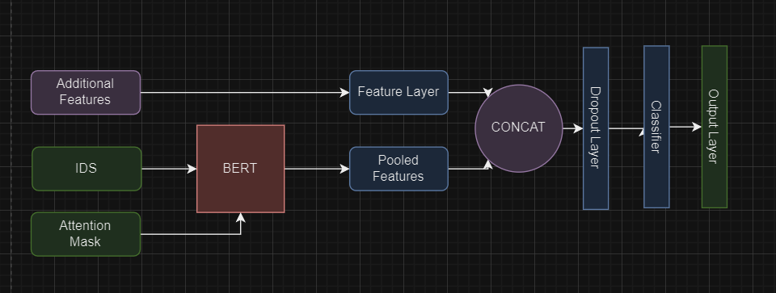
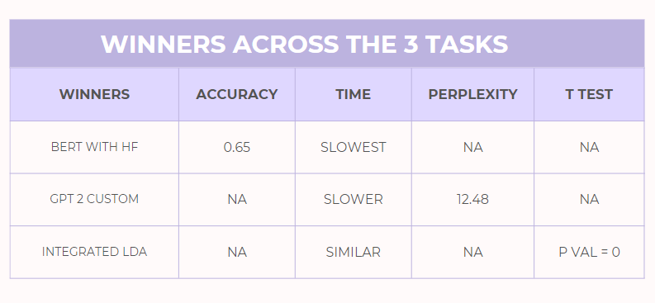
Analysis Of Emotional and Psychological Themes in Music over time and across genres
Aryan Patil Dhruv Charan Harsh Ramani
Introduction
Recommendation System
We use the T statistic to compare the two systems
Need of Human Evaluation
Numeric features are intrinsic and measure the following aspects:
Danceability, Acoustics, Romantic, Spiritual, Visual Perception, Instrumentalness, Loudness, Valence, Communication, Audience Shakability
Genres might be dismissed or recede in popularity over time. Is this fair? Or can we revive the music genres by adjusting the emotional themes associated with it?
Sentiment Analysis
Lyrics Generation
Results and Conclusion
Here we have the model for the feature adaptation we create in order to incorporate the non textual information into our model to give it a better idea of how to classify te data because there is a high correlation between some of the musical features and the emotional content of a song (not necessarily always but the model still performs markedly better)
Here we have an exploration of the distribution of these emotions over genres and eras, one interesting development is that music seems to have gotten more chipper and upbeat over time, also a lot of the suppositions we have about genres manifest themselves, like hip-hop where the predominant emotion seems to be excitement,whereas sadness seems to be eminent in blues (and surprisingly rock) There are more insights to be gotten out of this however we restricted our heatmap to the 13 top genres
By incorporating this deeper understanding of themes into music, we can more thoroughly comprehend the relationship between genre and lyrical symbolism and rationalize the lyrical ideas driving the continued relevance and survival of all genres and how these genres take shape over the course of time
Ex: Evolution of Country Music to express themes like Anger, Curiosity,
The two models are given the following prompt and asked to generate next lines -
“Talking away I don't know what I'm to say I'll say it anyway today's another day to find you Shying away I'll be coming for you love…”
Max Length of lyrics generated is 200. For the variant, we can generate texts upto 400 words until the model misbehaves
References
[1]Bonta, Venkateswarlu & Kumaresh, Nandhini & Naulegari, Janardhan. (2019). A Comprehensive Study on Lexicon Based Approaches for Sentiment Analysis. Asian Journal of Computer Science and Technology. 8. 1-6. 10.51983/ajcst-2019.8.S2.2037.
[2]Fang-Fei Kuo, Meng-Fen Chiang, Man-Kwan Shan, and Suh-Yin Lee. 2005. Emotion-based music recommendation by association discovery from film music. In Proceedings of the 13th annual ACM international conference on Multimedia (MULTIMEDIA '05). Association for Computing Machinery, New York, NY, USA, 507–510. https://doi.org/10.1145/1101149.1101263
[3]Medinic-Kazazic, M. (2012). Handbook of music and emotion: Theory, research, applications: Canadian journal of music. Intersections, 33(1), 107-110,116. Retrieved from http://proxy.library.stonybrook.edu/login?url=https://www.proquest.com/scholarly-journals/handbook-music-emotion-theory-research/docview/1517635819/se-2
[4]https://doi.org/10.1525/jpms.2018.300411
[5]https://huggingface.co/datasets/chloeliu/lyrics
[6]https://huggingface.co/datasets/amzar1303/lyrics/viewer/default/train
[7]Radford, A., Wu, J., Child, R., Luan, D., Amodei, D., & Sutskever, I. (2019). Language models are unsupervised multi task learners. OpenAI Blog, 1(8), 9.

